Slide 1
Module– 3 – Contents Problem Solving by searching, Probabilistic reasoning in AI
Solving problems by searching
Classical Search
Adversarial Search
Constraint Satisfaction Problems.
Probabilistic reasoning in AI
Bayesian networks
Hidden Markov Model.

Slide 2
CSE 228 – Principles of Artificial Intelligence
Module #3, Lecture #1

Slide 3
Contents
Agents & Environment
Solving Problems by Searching
Uninformed Search:
Breadth-First Search (BFS)
Cheapest-First Search (CFS)
Depth-First Search (DFS)

Slide 4

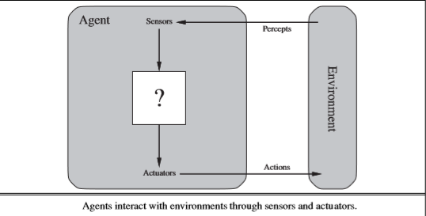
Agent & Environment
‘Anything’ that can gather information about its environment and take action based on that information.
In AI, an intelligent agent (IA) is an autonomous entity which observes through sensors and acts upon an environment using actuators and directs its activity towards achieving goals.
Intelligent agents may also learn or use knowledge to achieve their goals.
A rational agent is one that acts so as to achieve the best outcome or, when there is uncertainty, the best expected outcome.

Slide 5
Agents
A human agent
eyes, ears, and other organs for sensors
hands, legs, vocal tract, and so on for actuators.
A robotic agent
might have cameras and infrared range ﬁnders for sensors
various motors for actuators.
A software agent
receives keystrokes, ﬁle contents, and network packets as sensory inputs
acts on the environment by displaying on the screen, writing ﬁles, and sending network packets.

Slide 6
Agent…
Percept refers to the agent’s perceptual inputs at any given instant.
An agent’s percept sequence is the complete history of everything the agent has ever perceived.
An agent’s choice of action at any given instant can depend on the entire percept sequence observed to date, but not on anything it hasn’t perceived.
Mathematically speaking, we say that an agent’s behavior is described by the agent function that maps any given percept sequence to an action
One could view a hand-held calculator as an agent that chooses the action of displaying “4” when given the percept sequence “2 + 2 =,”

Slide 7
Solving problems by Searching
Goal-based agent called a Problem-solving Agent
Uninformed Search Algorithms—algorithms that are given no information about the problem other than its deﬁnition.
Although some of these algorithms can solve any solvable problem, none of them can do so efﬁciently
Informed Search Algorithms, on the other hand, can do quite well given some guidance on where to look for solutions

Slide 8
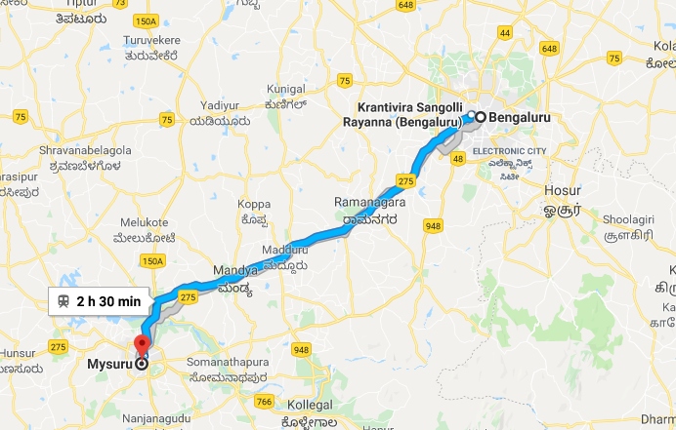
Problem : Travel from Bangalore to Mysore
If the agent has no additional information—i.e., if the environment is unknown in the sense—then it is has no choice but to try one of the actions at random.
But suppose the agent has a map of Karnataka
The point of a map is to provide the agent with information about the states it might get itself into and the actions it can take.
The agent can use this information to consider subsequent stages of a hypothetical journey via each of the towns, trying to ﬁnd a journey that eventually gets to Mysore.
Once it has found a path on the map from Bangalore to Mysore, it can achieve its goal by carrying out the driving actions that correspond to the legs of the journey.
An agent with several immediate options of unknown value can decide what to do by ﬁrst examining future actions that eventually lead to states of known value.
OBSERVABLE :The agent always knows the current state.
DISCRETE: At any given state there are only ﬁnitely many actions to choose from
KNOWN : The agent knows which states are reached by each action
DETERMINISTIC : Each action has exactly one outcome
Under these assumptions, the solution to any problem is a ﬁxed sequence of actions.
The process of looking for a sequence of actions that reaches the goal is called search.

Slide 9
Well Defined Problem
A problem can be defined formally by five components:
1. Initial State
2. A set of actions
3. Transition Model
4. Goal Test / Goal State
5. Path Cost

Slide 10
Initial State
The initial state that the agent starts in. For example, the initial state for our agent in Bangalore might be described as In(Bangalore).

Slide 11
Permitted Actions
A description of the possible actions available to the agent.
Given a particular state s, ACTIONS(s) returns the set of actions that can be executed in s.
Each of these actions is applicable in s.
For example, from the state In(Bangalore), the applicable
Actions are ----- {Go(Hosur), Go(Kunigal), Go(Kolar)}.

Slide 12
Transition Model
A description of what each action does; the formal name for this is the transition model, specified by a function RESULT(s, a) that returns the state that results from doing action a in state s.
We also use the term successor to refer to any state reachable from a given state by a single action.
For example, RESULT (In(Bangalore),Go(Hosur)) = In(Hosur).
Together, the initial state, actions, and transition model implicitly define the state space of the problem—the set of all states reachable from the initial state by any sequence of actions.
The state space forms a directed network or graph in which the nodes are states and the links between nodes are actions.
(The map of Karnataka can be interpreted as a state-space graph if we view each road as standing for two driving actions, one in each direction.)
A path in the state space is a sequence of states connected by a sequence of actions.

Slide 13
Goal Test
The goal test, which determines whether a given state is a goal state.
Sometimes there is an explicit set of possible goal states, and the test simply checks whether the given state is one of them.
The agent’s goal in Karnataka is the singleton set {In(Mysore)}.

Slide 14
Path Cost
A path cost function that assigns a numeric cost to each path. The problem-solving agent chooses a cost function that reflects its own performance measure.
For the agent trying to get to Mysore, time is of the essence, so the cost of a path might be its length in kilometers.
Cost of a path can be described as the sum of the costs of the individual actions along the path.
The step cost of taking action a in state s to reach state s’ is denoted by c(s, a, s’)
The step costs for Karnataka are route distances.

Slide 15
Well Defined Problem…..
A solution to a problem is an action sequence that leads from the initial state to a goal state.
Solution quality is measured by the path cost function, and an optimal solution has the lowest path cost among all solutions.
The process of removing detail from a representation is called abstraction. (Like Weather, Road Condition etc.)
The choice of a good abstraction thus involves removing as much detail as possible while retaining validity and ensuring that the abstract actions are easy to carry out.

Slide 16
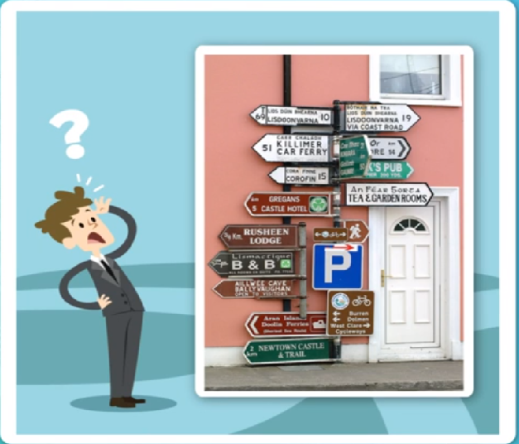

NAVIGATION PROBLEM

Slide 17
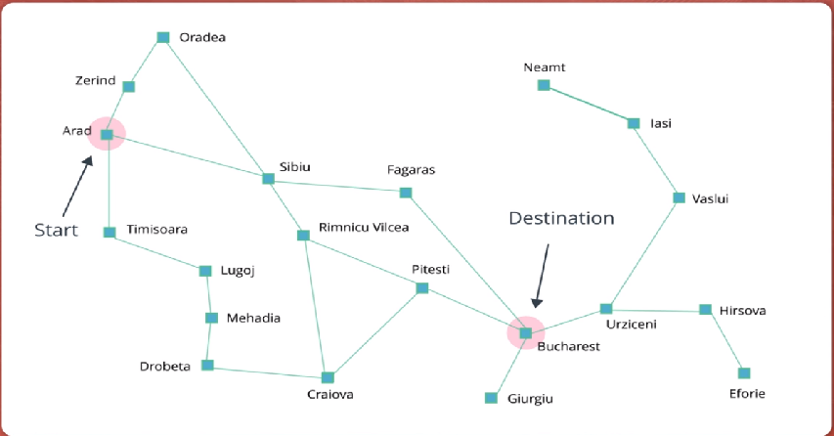
Romania
Problem : Arad To Bucharest
Solution ????

Slide 18
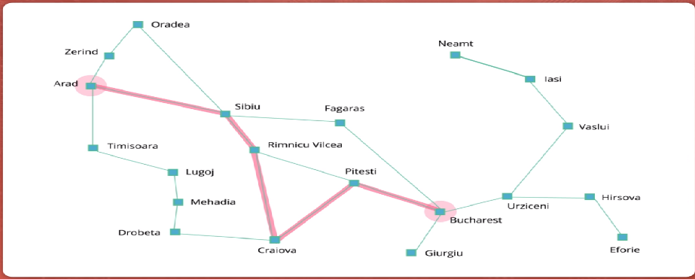
One Solution……

Slide 19
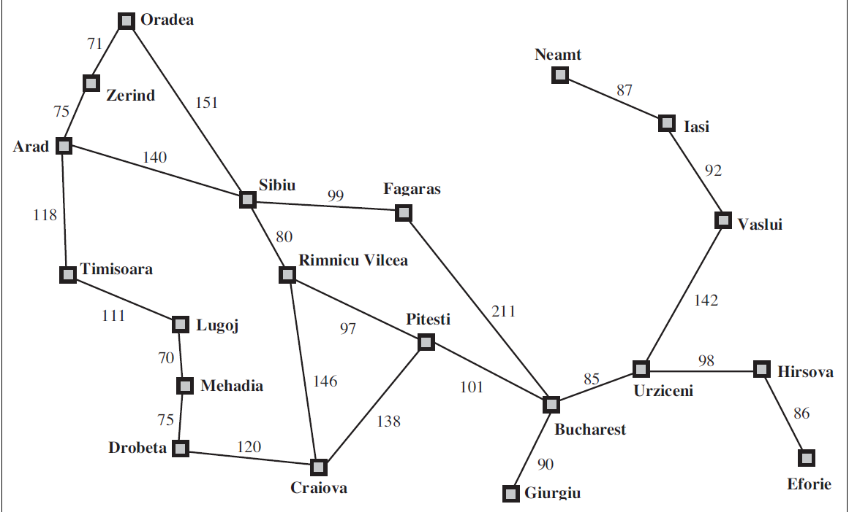
Map of Romania Problem: Arad to Bucharest

Slide 20
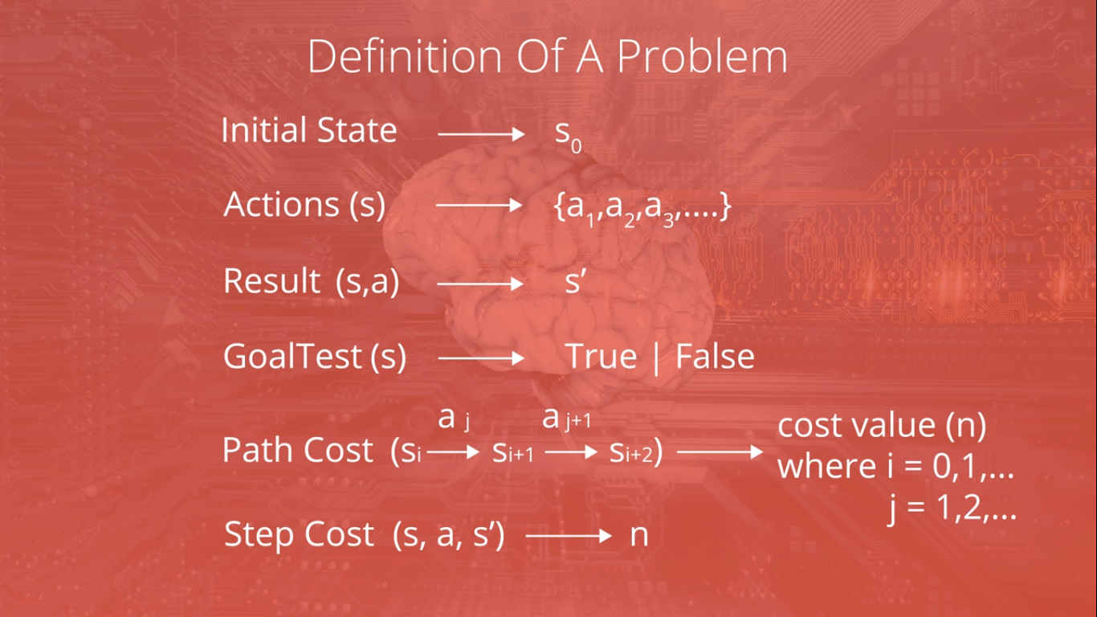

Slide 21
Uninformed Search
These strategies have no additional information about states beyond that provided in the problem definition, so they can only proceed by generating successors until they find a goal state.
BREADTH FIRST
CHEAPEST FIRST
DEPTH FIRST

Slide 22
INFORMED SEARCH / (HEURISTIC SEARCH)
These strategies have additional information about search states, so they can guide the search by ranking successors according to some fitness score until they find a goal state.
A* Search
AO* Search

Slide 23
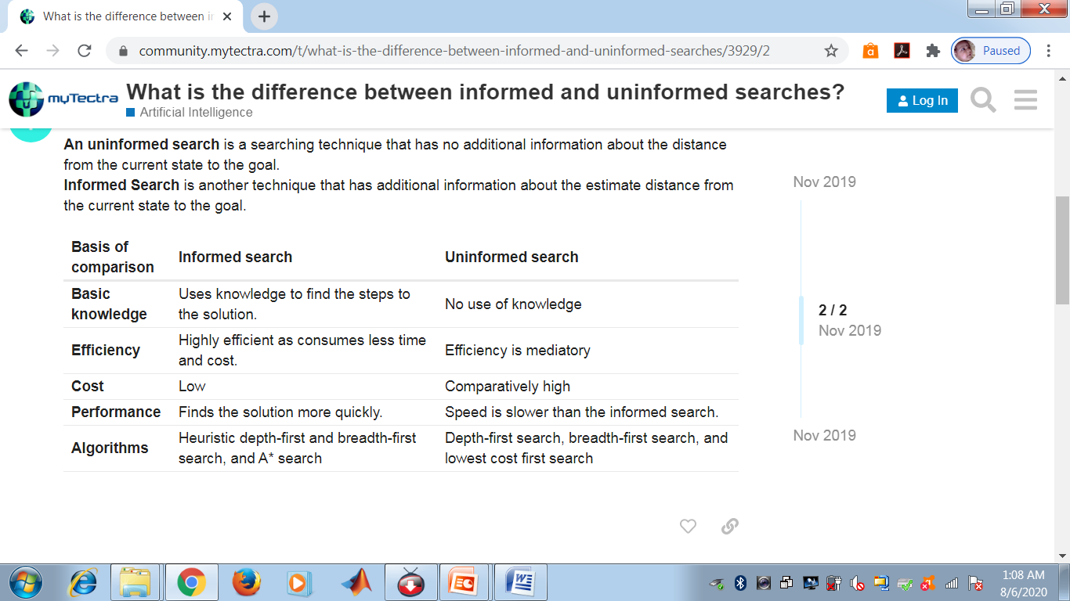

Slide 24
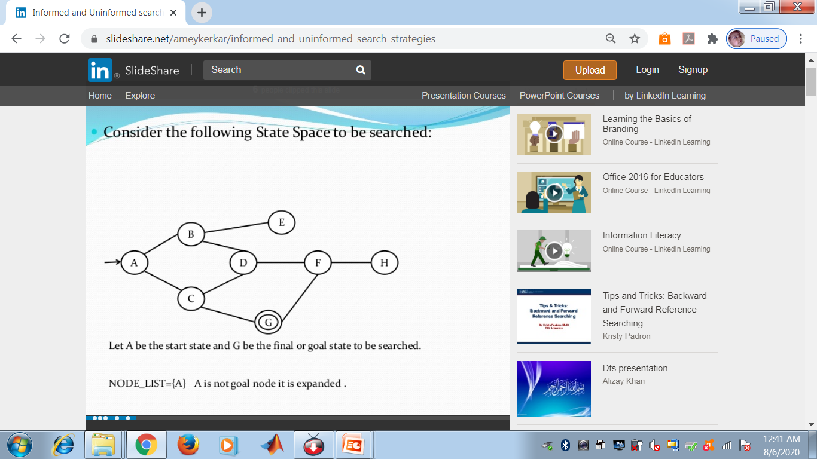
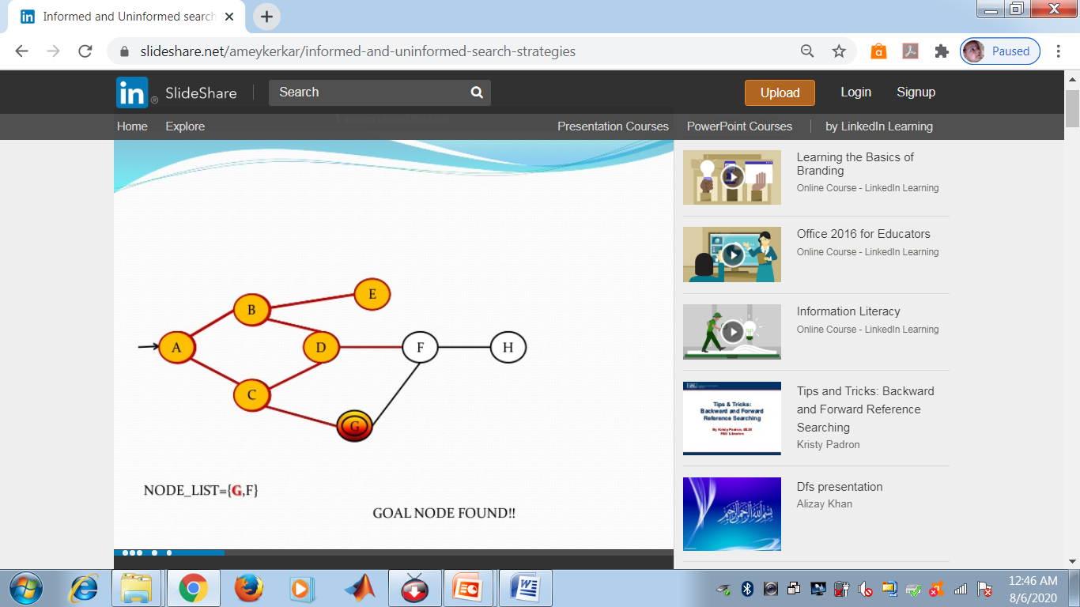

BFS

Slide 25
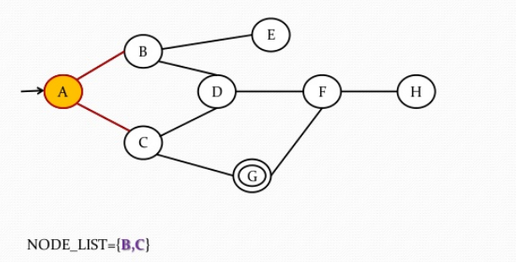

Slide 26
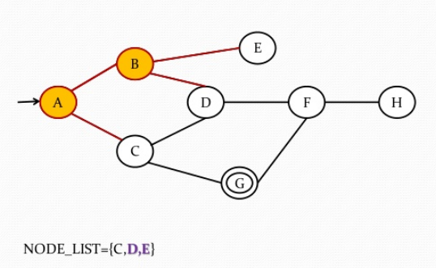

Slide 27
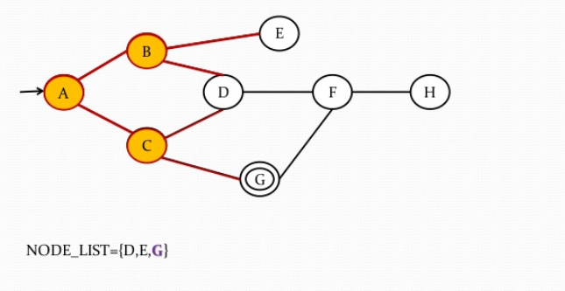

Slide 28


Slide 29


Slide 32
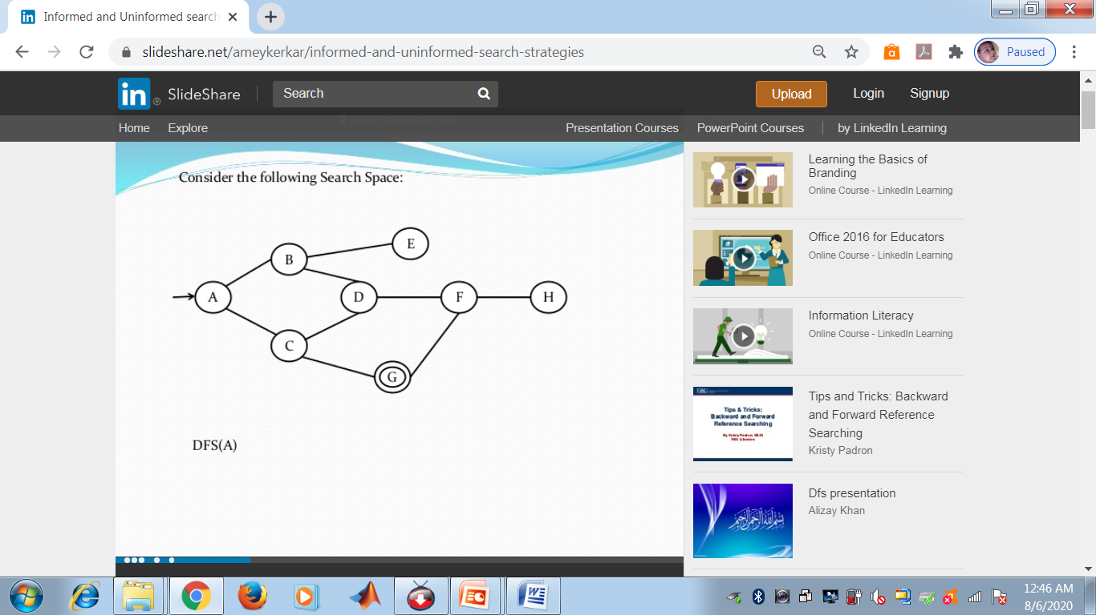






DFS

Slide 33


Slide 34


Slide 35
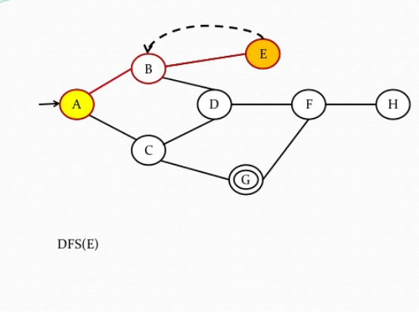

Slide 42
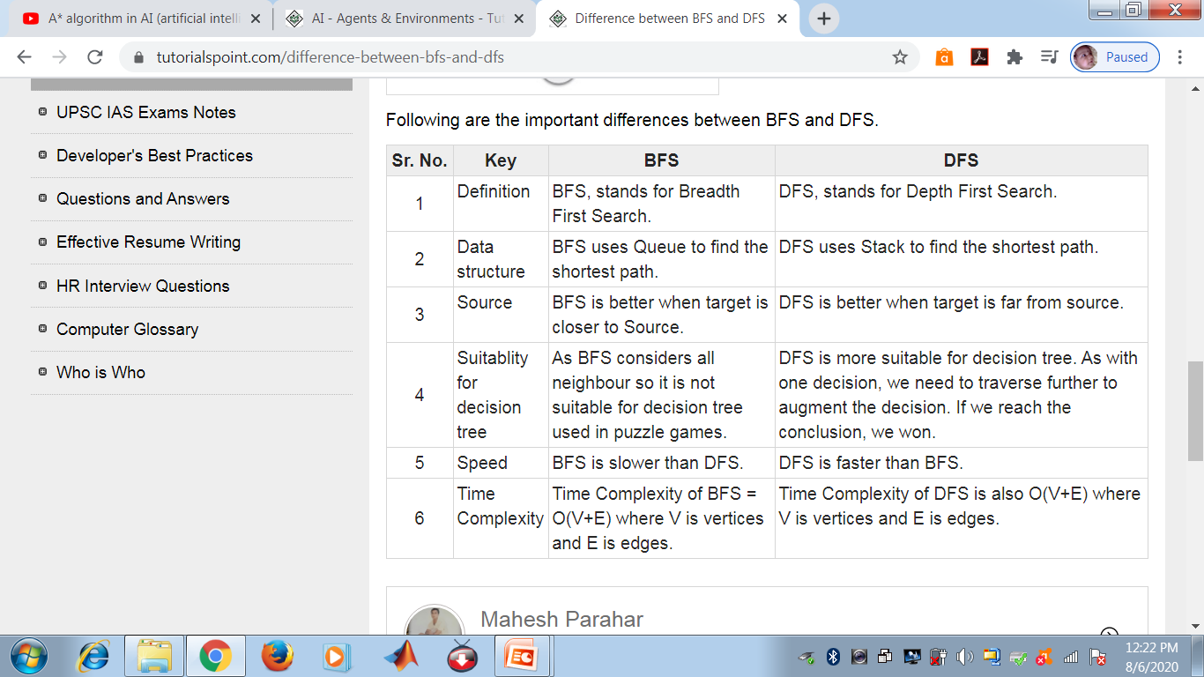

Slide 43
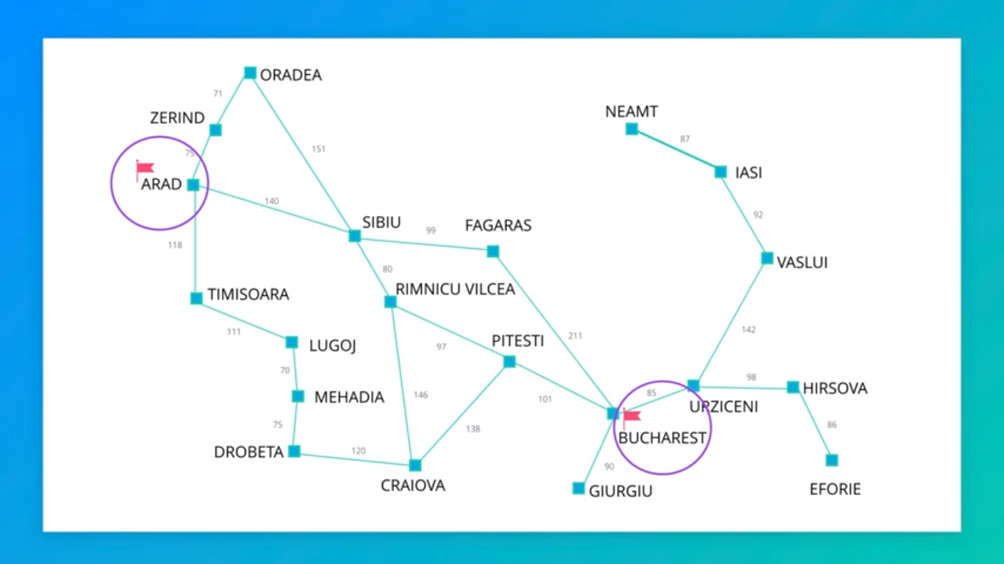

Slide 44
Searching For Solutions
The possible action sequences starting at the initial state form a search tree with the initial state at the root; the branches are actions and the nodes correspond to states in the state space of the problem.
The root node of the tree corresponds to the initial state, In(Arad).
The first step is to test whether this is a goal state. As it is not
We need to consider taking various actions. We do this by expanding the current state; that is, applying each legal action to the current state, thereby generating a new set of states.
In this case, we add three branches from the parent node In(Arad) leading to three new child nodes: In(Sibiu), In(Timisoara), and In(Zerind).
Now we must choose which of these three possibilities to consider further.
Leaf node is a node with no children in the tree.
The set of all leaf nodes available for expansion at any given point is called the frontier.
Loopy Path
Redundant Path

Slide 45
Terms…
State Space : Entire Area
Actions : Navigate the State Space
Actions are specific to each state
Frontier
Explored & Unexplored

Slide 46
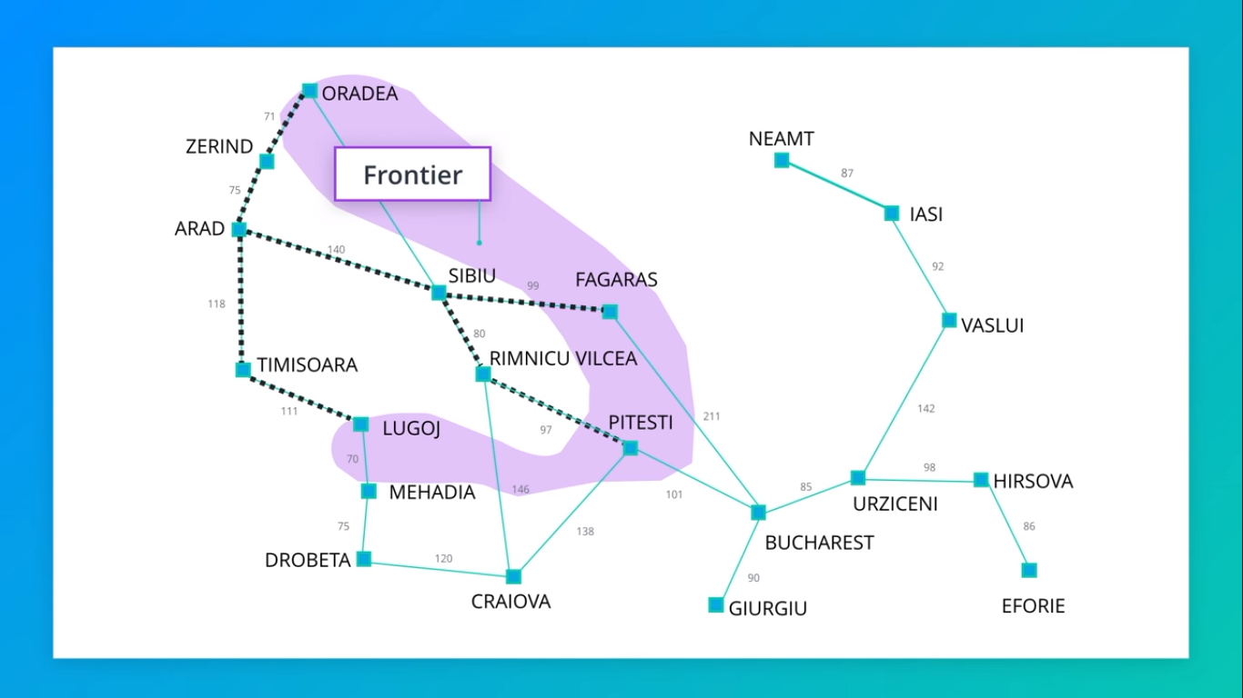

Slide 47
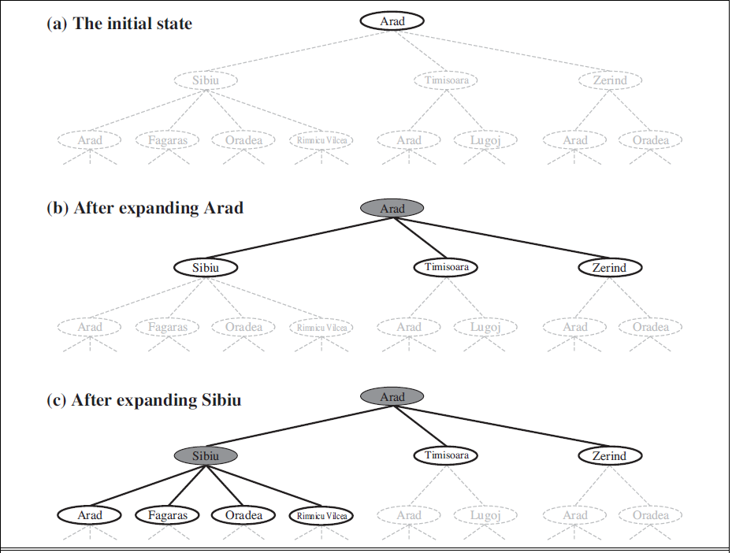

Slide 48
The way to avoid exploring redundant paths is to remember where one has been.
To do this, we augment the TREE-SEARCH algorithm with a data structure called the explored set which remembers every expanded node.
Newly generated nodes that match previously generated nodes—ones in the explored set or the frontier—can be discarded instead of being added to the frontier.
The new algorithm, called GRAPH-SEARCH
In GS the frontier separates the state-space graph into the explored region and the unexplored region, so that every path from the initial state to an unexplored state has to pass through a state in the frontier

Slide 49
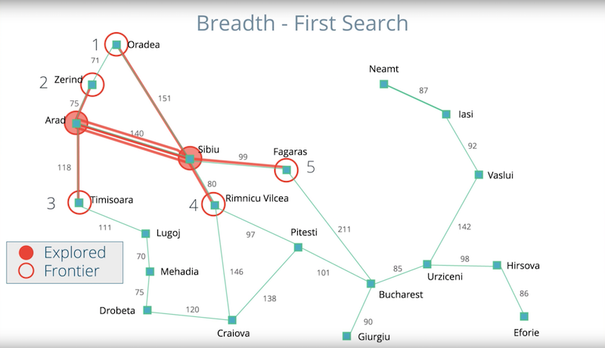
Breadth FIRST SEARCH / Shortest FIRST SEARCH
NEXT WHICH To Explore ????

Slide 50
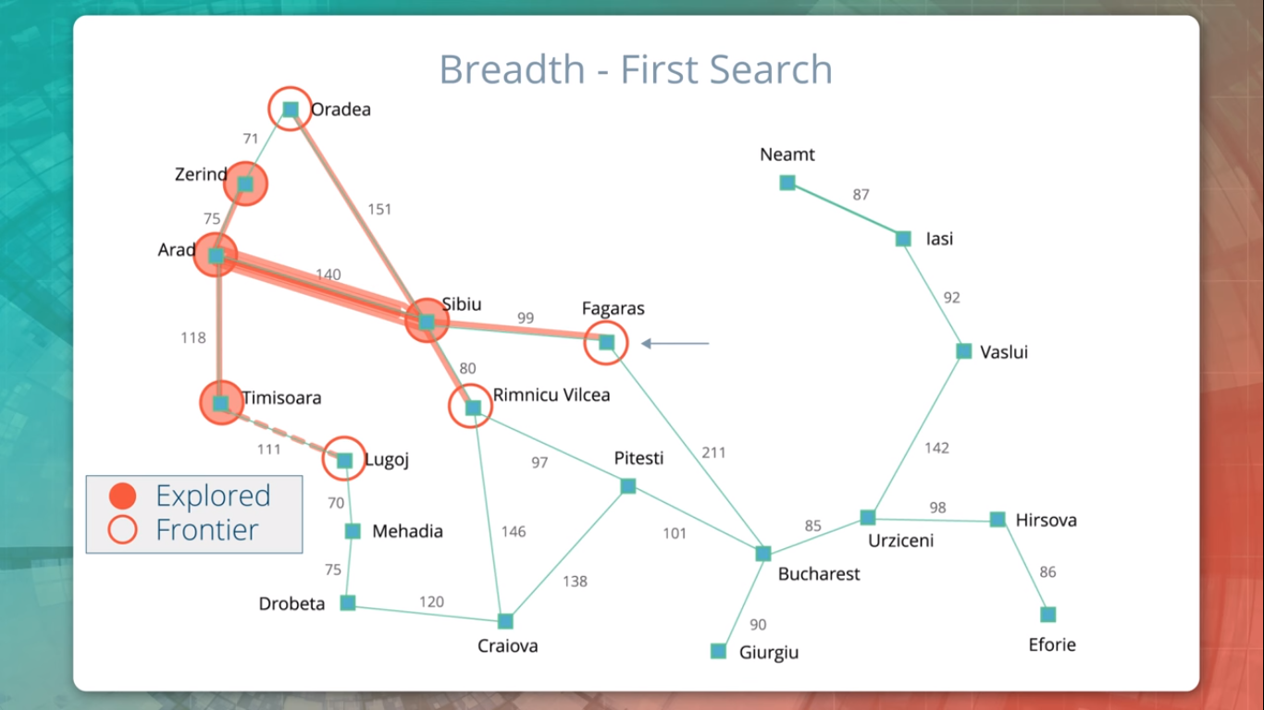
Which Next ???
Do We Terminate ???

Slide 51
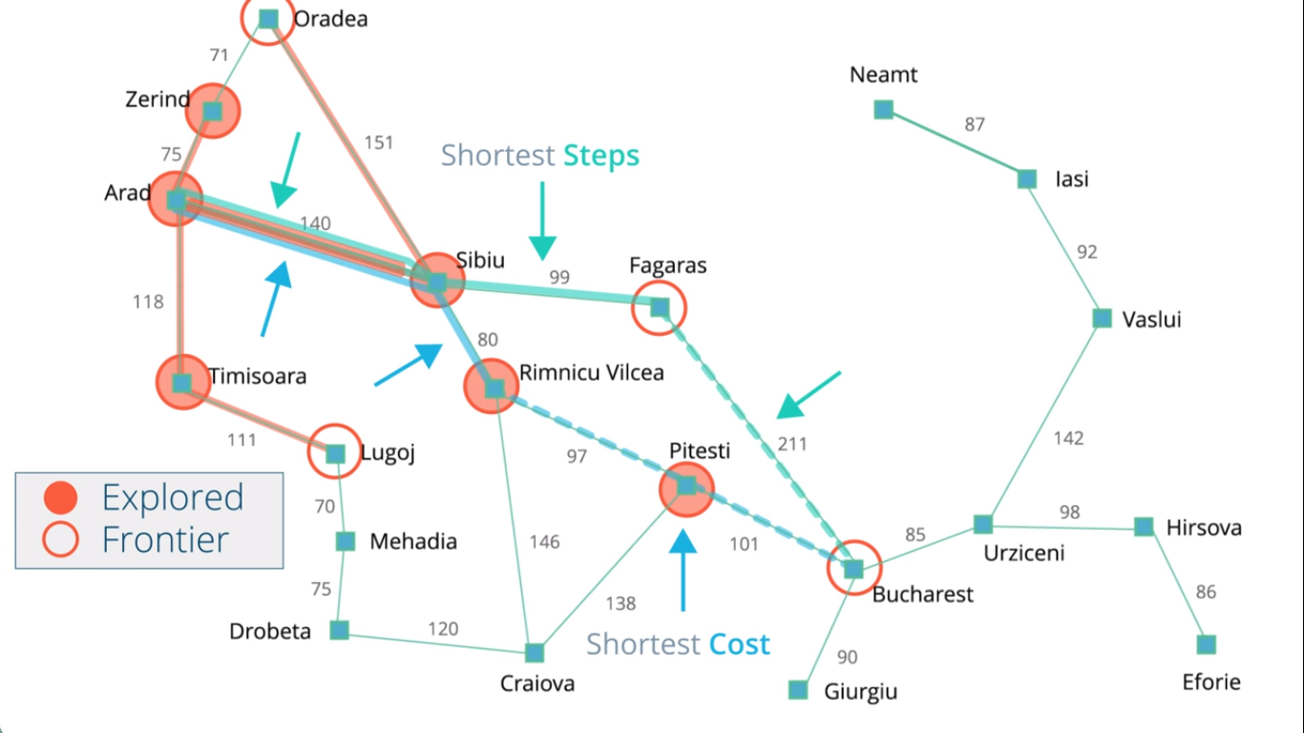

Slide 52
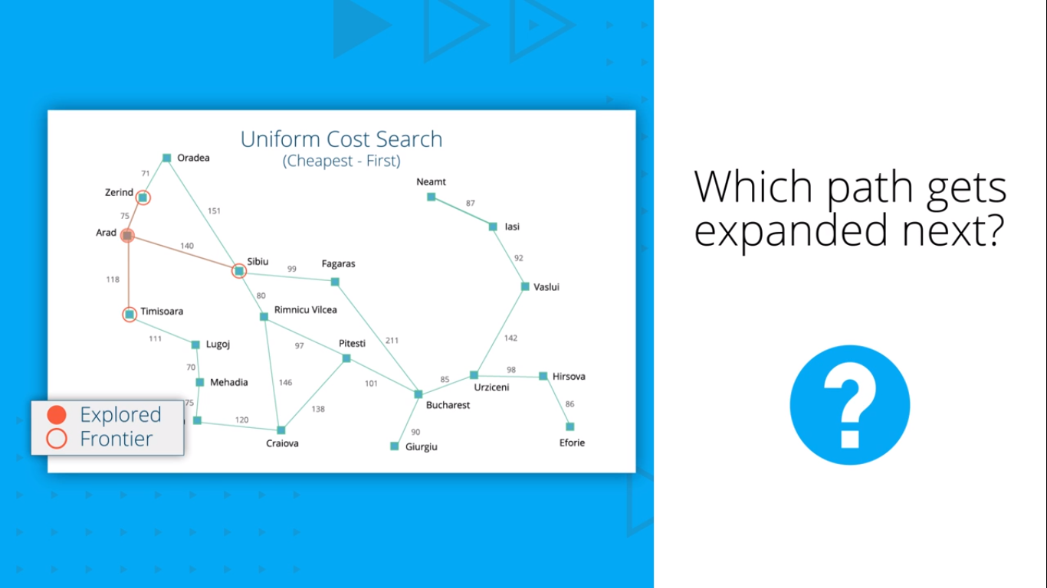
UNIFORM- COST SEARCH/Cheapest First

Slide 53
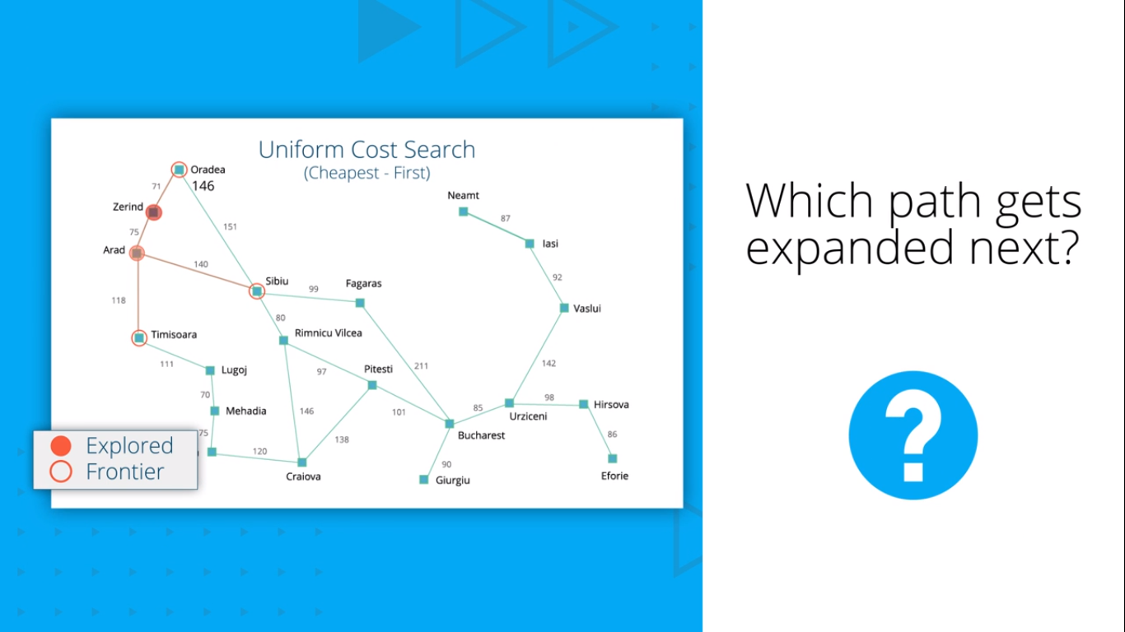

Slide 54


Slide 55
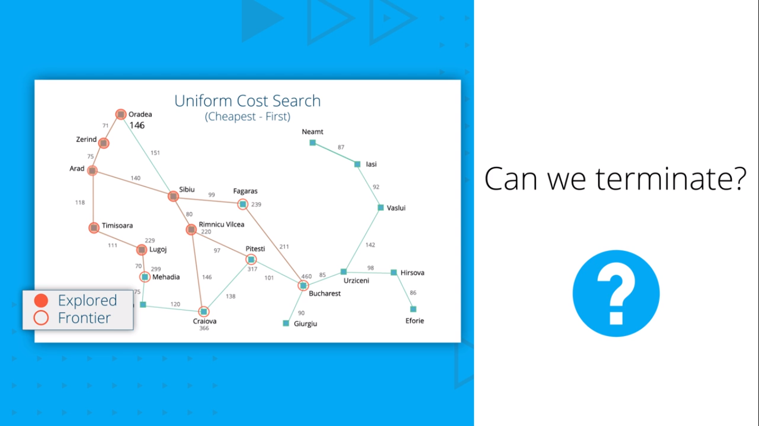

Slide 56
UNIFORM COST SEARCH CONTINUES TILL WE POP OFF THE PATH FROM THE FRONTIER

Slide 57
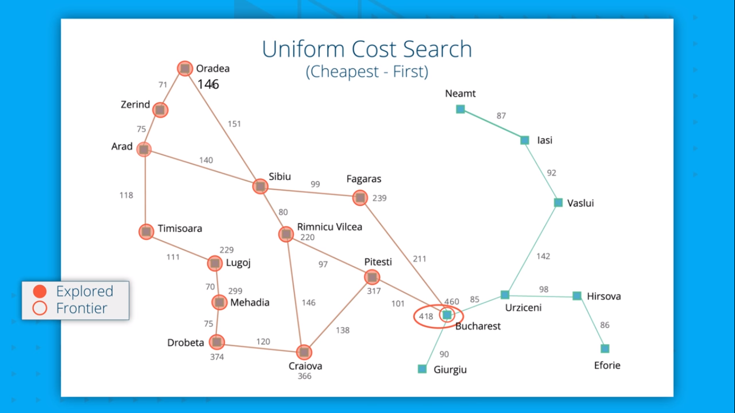

Slide 58
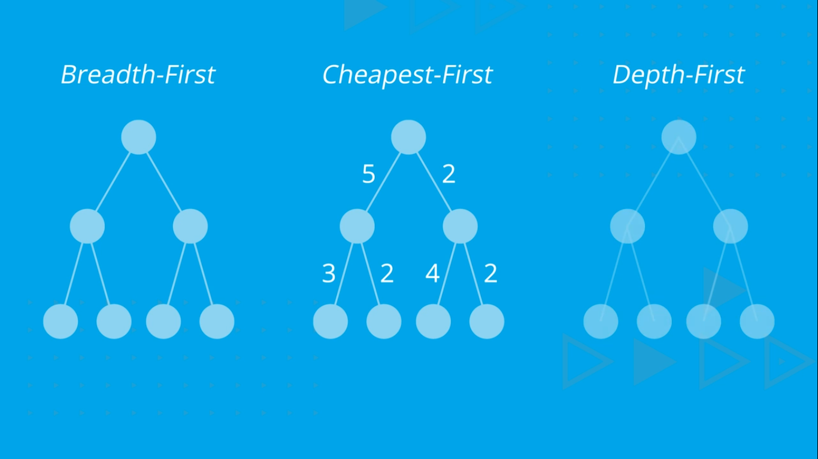
NUMBER IT IN ORDER OF PROCESSING BREAK TIE FROM LEFT TO RIGHT

Slide 59
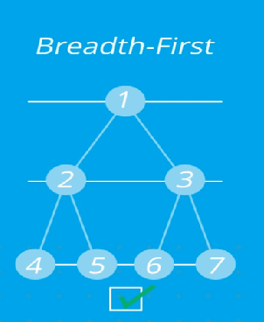
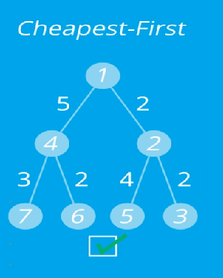
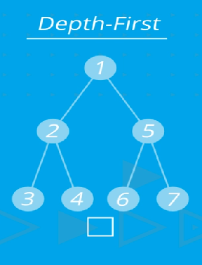

Slide 60
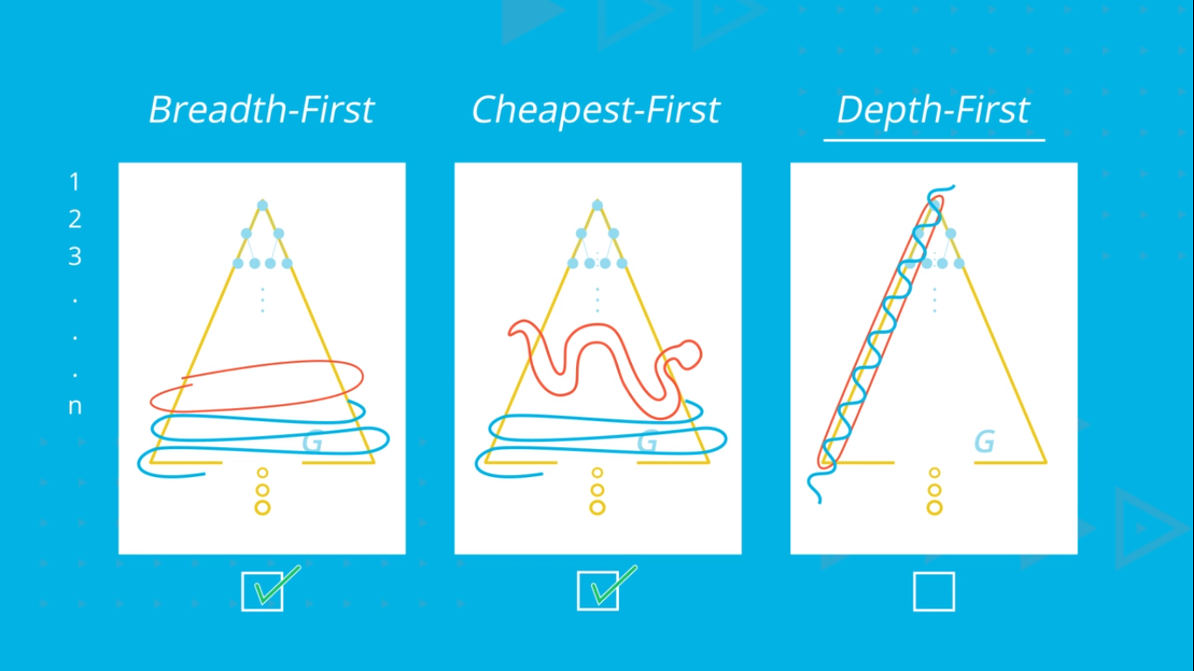
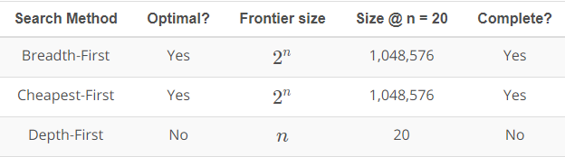

Slide 61
Disclaimer
The content in the slides is amalgamated from web and not my own

